Slide 1
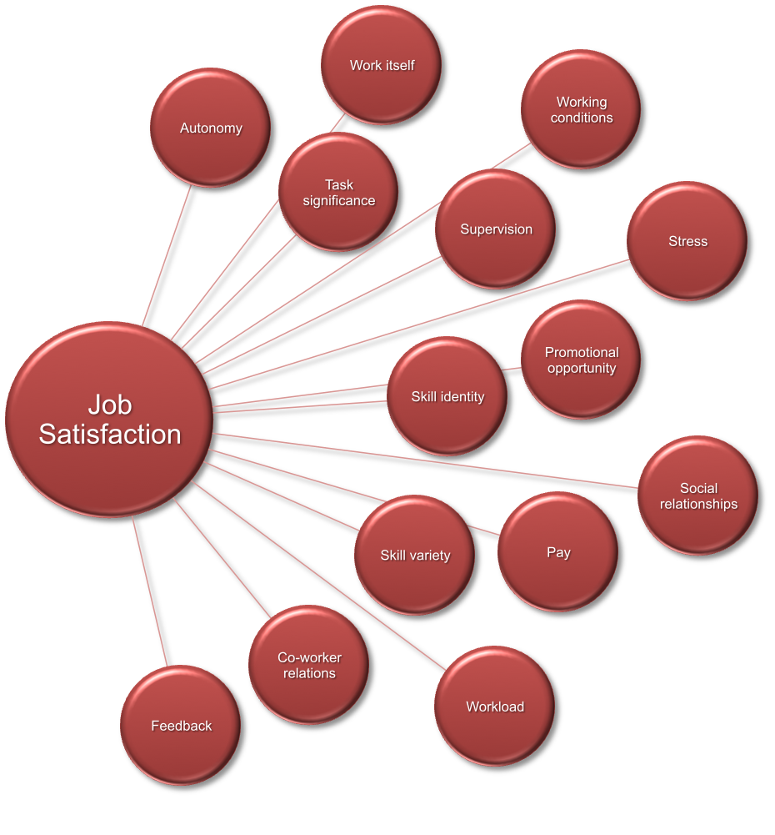

CAREER SATISFACTION ANALYSIS
(USING BIG DATA TOOLS)
BY
Kaushik BVK, Pratibha Rai, Wanyang Cheng & Zhenhao Zong
Northeastern University

Slide 2

AGENDA
INTRODUCTION
FACTORS RELATED TO THE JOB
EMPLOYMENT & GENDER
EDUCATION
RACE & INCOME
KEY INSIGHTS
REFERENCES

Slide 3

















INTRODUCTION
What impacts career satisfaction ?
Tools Used for Analysis
Where to find Data?
51 thousand rows, 150+ columns

Slide 4
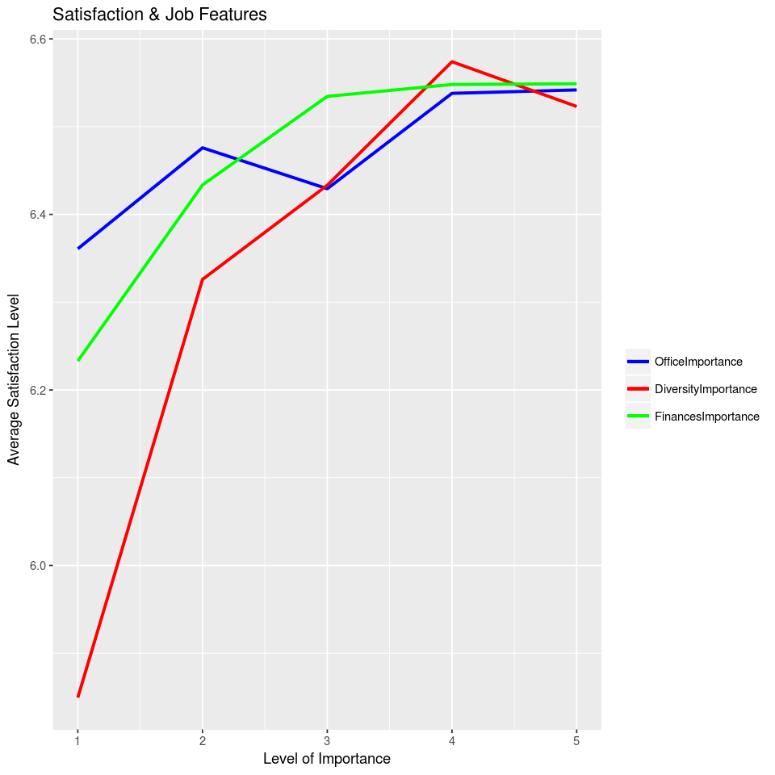
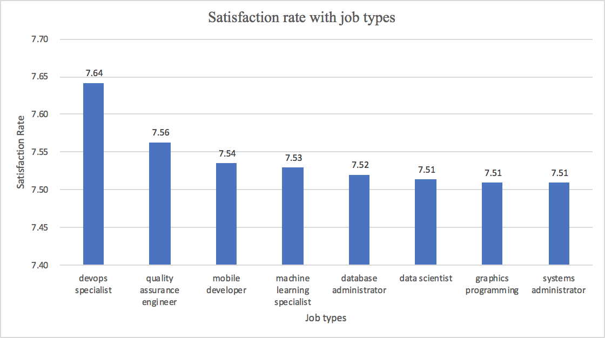
FACTORS RELATED TO JOB
Factors Affecting Career Satisfaction in IT
Most Satisfying Careers in IT
JOB DIVERSITY
JOB FINANCE
OFFICE
DEVOPS SPECIALIST
QUALITY ASSURANCE ENGINEER
MOBILE DEVELOPER
Figure 1. Satisfaction rate with Job features
Figure 2. Career Satisfaction rate with Respect Job Type

Slide 5
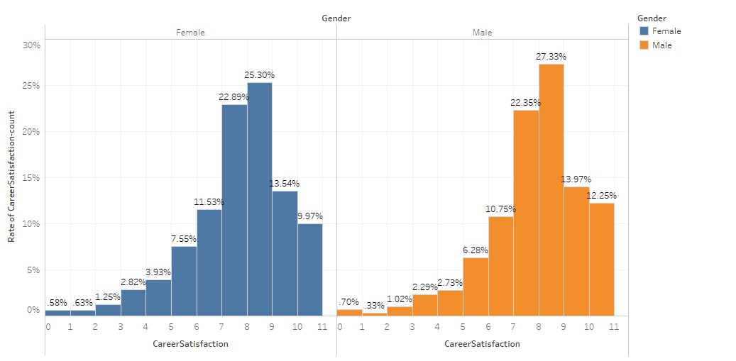
CAREER SATISFACTION VS GENDER
Career satisfaction rate doesn’t seem to vary much with gender, and the distribution of the proportions for the two genders are also very similar.
We can conclude that gender does not strongly influence people’s satisfaction with their careers.
Figure 3. Career satisfaction based on gender

Slide 6
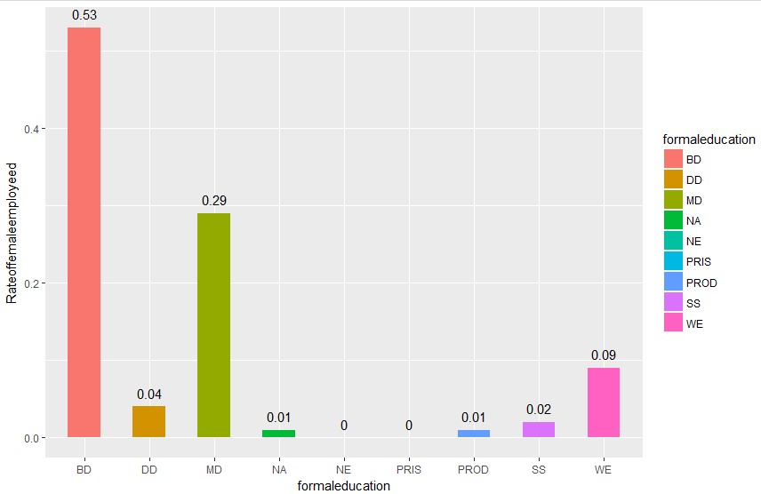
EMPLOYMENT VS EDUCATION (FEMALE)
Women with bachelor degrees have the highest employment rate, followed by women with a master's degree;
The women who got a Doctoral degree have much lower employment rate in IT industry; even lower than the women without any college degree. It supplements the research that suggests job market for Ph.D’s is shrinking (McKenna).
Employment is challenging for women who have only graduated from primary school or have not received formal education.
Figure 4. Employment vs Education Level for Females
* Where the 'BD','DD','NE','NA','MD','PRIS','PROD','SS','WE' respectively describe Bachelor's degree, Doctoral degree, Master's degree, I prefer not to answer, I never completed any formal education, Primary/elementary school, Professional degree, Secondary school and Some college/university study without earning a bachelor's degree.

Slide 7
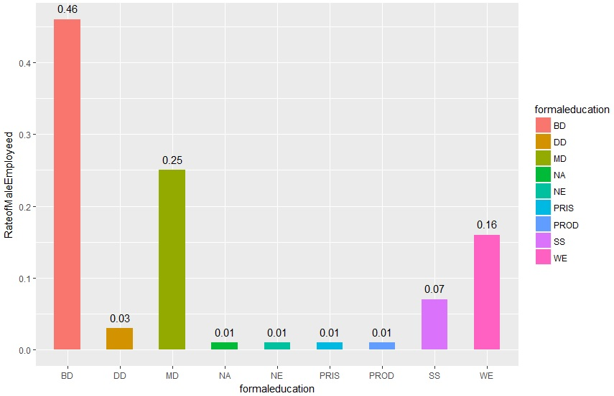
EMPLOYMENT VS EDUCATION (MALE)
Just like women, men with a bachelor's degree have the highest employment rate, followed by the ones with masters.
Men who attended college but did not completed their degree had significantly higher employment rates than women, in IT industry.
The employment rate of male with primary school education, secondary education, and no education is also relatively higher than that of women
Figure 5. Employment vs Education Level for Males

Slide 8
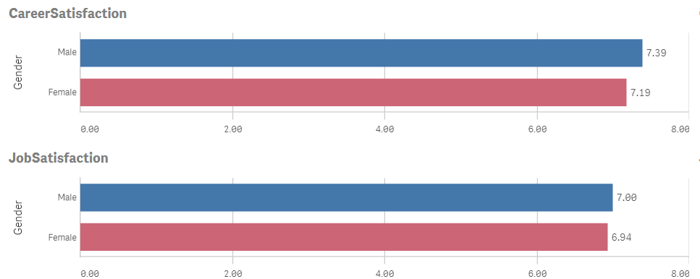
BASED ON GENDER
Career Satisfaction with Gender
Total Career Satisfaction is 14.58 across both entities.
The distribution ranges from 7.19 (Female) to 7.39 (Male), a difference of 0.21, averaging 7.29.
Job Satisfaction with Gender
Total Job Satisfaction is 13.94 across both entities.
The minimum value is 6.94 (Female) and the maximum is 7.00 (Male), a difference of 0.07, averaging 6.97.
Figure . 6 Career Satisfaction and Job Satisfaction patterns based on Gender
There seems to be very little variance in Job satisfaction levels across genders

Slide 9
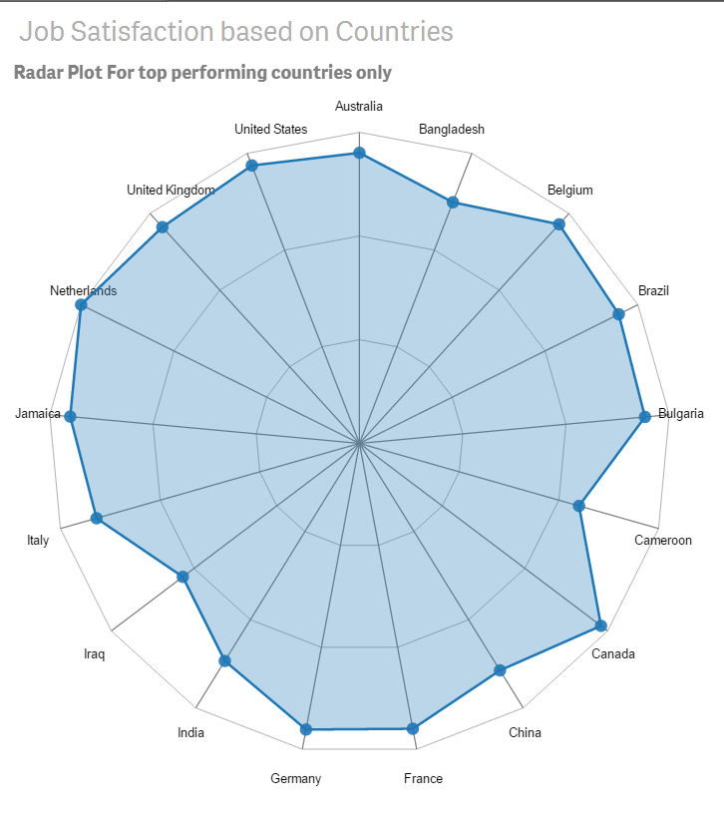
JOB SATISFACTION VS COUNTRIES
This chart measures average job satisfaction across countries.
Total Avg(Job Satisfaction) is 114 across all 17 entities.
Cameroon has lowest satisfaction rate (5) whereas the maximum is 7 (Netherlands).
Countries in European and American continents have relatively higher job satisfaction.
Cameroon is an outlier with a very low average Job satisfaction rate.
Figure 7. Job Satisfaction Across Countries

Slide 10
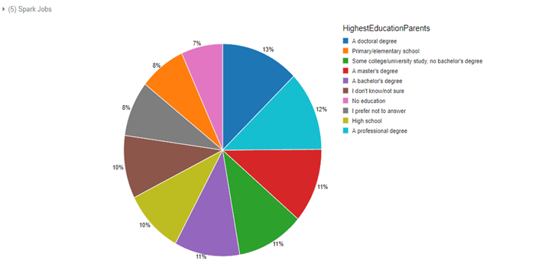
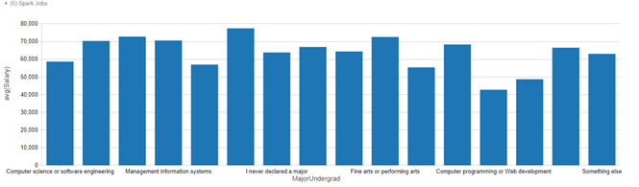
IS PARENT’S EDUCATION A FACTOR?
Degree | Salary
A Doctoral Degree | $ 69934.70
Primary Elementary School | $ 41454.78
College Study, No Bachelor’S Degree | $ 60,381.30
A Master’S Degree | $ 62131
I Don’T Know/Not Sure | $ 52539.18
No Education | $ 37254.59
I Prefer Not To Answer | $ 46216.74
High School | $53,178.63
A Professional Degree | $ 66492.61
Figure 8. Importance of parent’s education

Slide 11
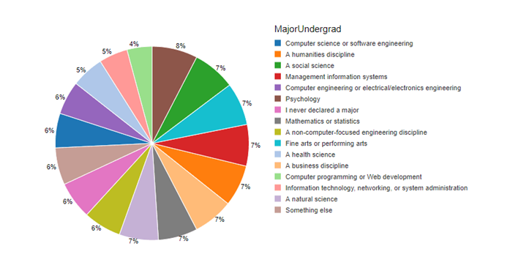
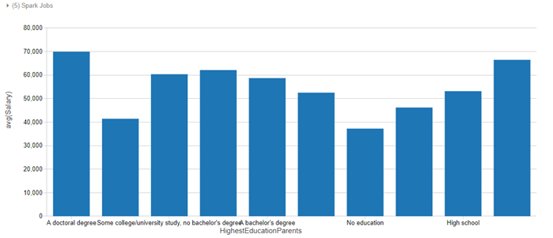
MAJOR UNDERGRADUATE & SALARY
Computer science or software engineering $ 58661.54
A human discipline $ 70340.38
A social science $ 72771.91
Management information systems $ 70570.94
Computer engineering or electrical/electronic engineering $ 56970.47
Psychology $ 77431.36
I never declared a major $ 63792.46
Mathematics or statistics $ 66914.40
A non-computer-focused engineering discipline $ 64354.22
Fine arts or performing arts $ 72579.89
A health science $ 55420.33
A Business discipline $ 68319
Computer programming or Web development $ 42767.31
Information technology, networking, or system administration $ 48667.89
A natural science $ 66487.40
Something else $ 63029.91
Figure 7.
Figure 9. Impact of Education levels on Salary

Slide 12
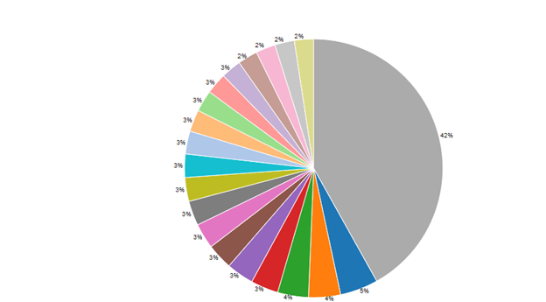
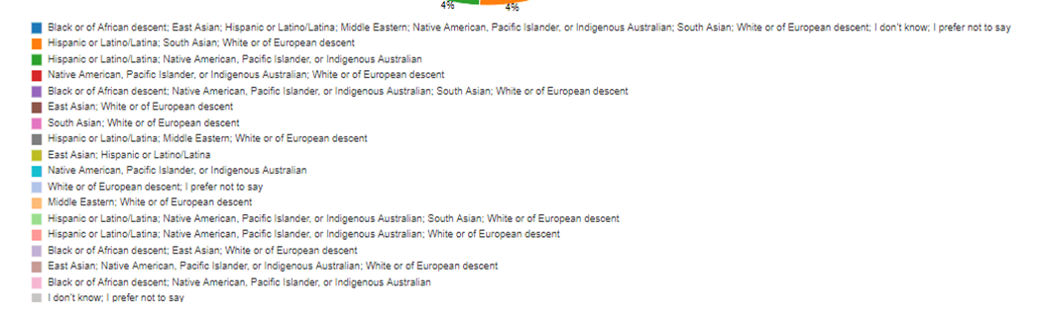
RACE & SALARY
$ 125, 000
$ 105, 000
$ 101, 250
$ 90, 391
$ 90, 000
$ 84, 815
$ 83, 082
$ 80, 862
$ 78, 232
$ 76, 597
$ 75, 154
$ 71, 583
$ 70, 440
$ 69, 034
$ 66, 250
$ 64, 731
$ 64, 587
$ 64, 013
Figure 10. Analysis of average salary with respect to race

Slide 13
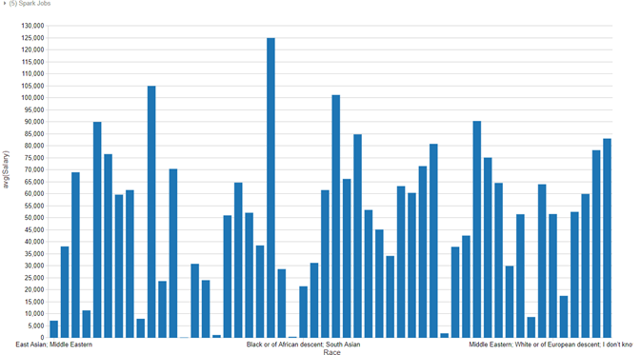
RACE & SALARY
Figure 11. Analysis of average salary for each race

Slide 14
KEY INSIGHTS
It helps improve job satisfaction, if one thinks about various aspects of work, such as commute, office, project, diversity, etc. upfront.
Those with bachelor’s and master's degree have the higher employment rate in IT industry. But men with lesser education have better chances of employment as compared to women.
Not only one’s own education is factor, but parent’s education is also a great influence on individuals’ income and career satisfaction level.
Regardless of gender, men and women have similar career satisfaction levels in IT industry.
Native individuals have relatively more employment opportunities as compared to individuals non-native population.

Slide 15
REFERENCES
Apache Spark. (n.d.). SparkR (R on Spark). Retrieved from https://spark.apache.org/docs/latest/sparkr.html
Jonathan. (2017). Stack Overflow Developer Survey. Retrieved from https://www.kaggle.com/stackoverflow/so-survey-2017/data
McKenna, L. (April 21, 2016). The Ever-Tightening Job Market for Ph.D.s https://www.theatlantic.com/education/archive/2016/04/bad-job-market-phds/479205/

Slide 16
THANK YOU
Northeastern University

